Slide 1
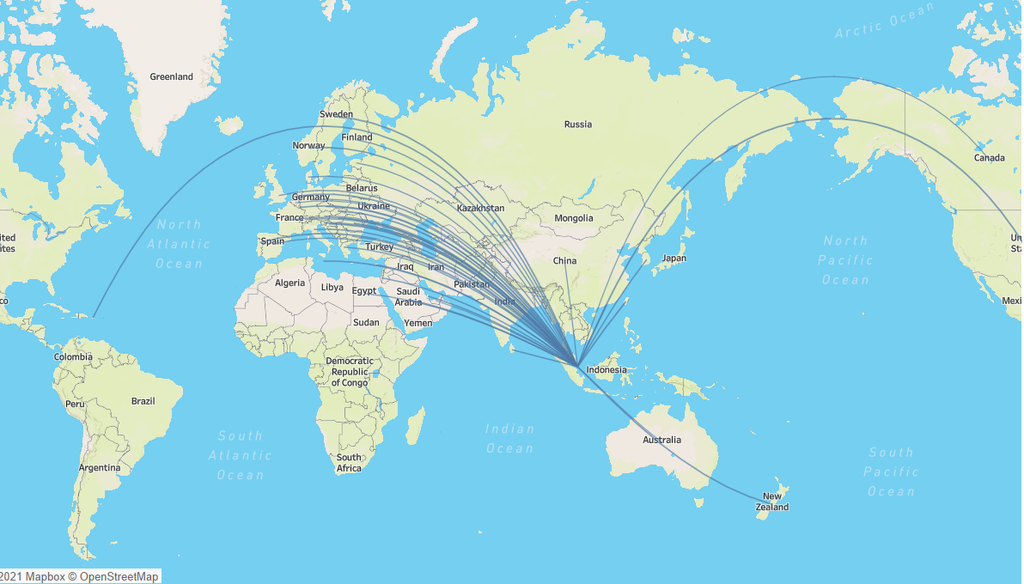
AGENDA | COMPANY OVERVIEW | PROJECT OBJECTIVE| MIDREVIEW RECAP | DASHBOARD | TIME SERIES & REGRESSION | RECOMMENDATION
SAP Data
Operation Data (SINCO)
Key Account Data
Account Master- Sales Person
Notes:
The above map gives how complex the network of DHL is ? Its just visualization of one month shipments, So imagine how much important data is to derive the insights in right direction.

Slide 2


AGENDA | COMPANY OVERVIEW | PROJECT OBJECTIVE| MIDREVIEW RECAP | DASHBOARD | TIME SERIES & REGRESSION | RECOMMENDATION
To understand and analyse the data and identify key performance indicators which would facilitate sales team to gain insights about individual territory and trends.
Key Merchant Management (KAM) Trends Dashboard
To understand and analyse the data and find correlation amongst various variables from the SAP and Operations data.
To analyse the trends in addition to the weight, volume, sales, destination country, material type, package type and transit item driven trends and make available data in easy to grasp and desirable form.
To establish and enhance the Key Merchant Management trends and create a dashboard on Tableau for same.
Key Insights and trends at SG Country Level
To enhance the filtering options in the trends in order to facilitate sales team to have a meaningful conversation with merchants.

Slide 3
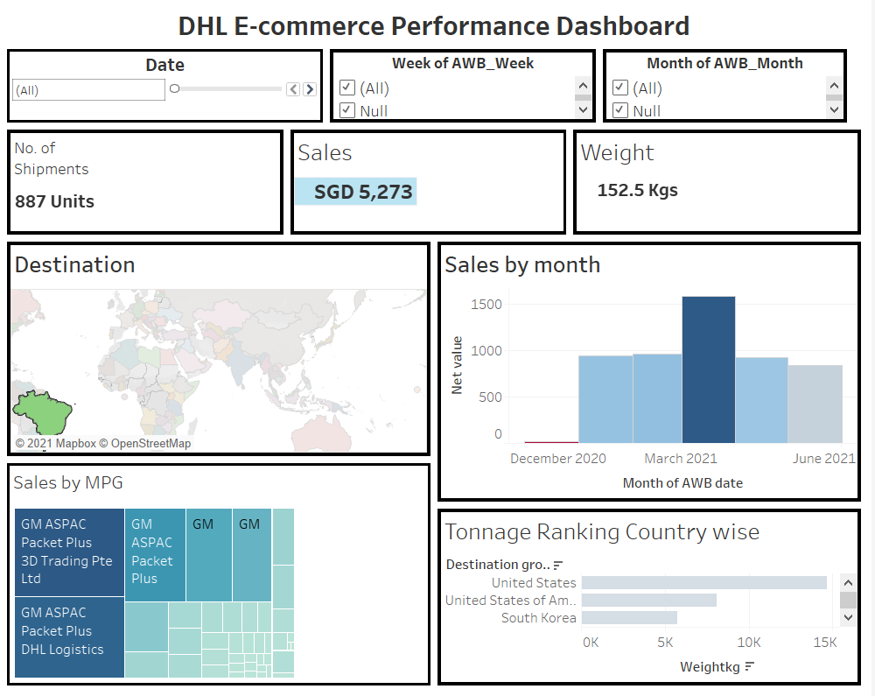
AGENDA | COMPANY OVERVIEW | PROJECT OBJECTIVE| MIDREVIEW RECAP| DASHBOARD | TIME SERIES & REGRESSION | RECOMMENDATION
Tableau Dashboard

Slide 4
Time Series Decomposition(Weekly Moving Average)
AGENDA | COMPANY OVERVIEW | PROJECT OBJECTIVE| MIDREVIEW RECAP| DASHBOARD | TIME SERIES & REGRESSION | RECOMMENDATION
What if Analysis

Slide 5
INCREASING TREND FOR PACKET PLUS & PARCEL DIRECT
AGENDA | COMPANY OVERVIEW | PROJECT OBJECTIVE| MIDREVIEW RECAP| DASHBOARD | TIME SERIES & REGRESSION | RECOMMENDATION
Product Trend

Slide 6
DECREASING TREND-PACKET & BUSINESS
AGENDA | COMPANY OVERVIEW | PROJECT OBJECTIVE| MIDREVIEW RECAP| DASHBOARD | TIME SERIES & REGRESSION | RECOMMENDATION
Product Trend

Slide 7
HIGH IRREGULARITY BEYOND 7% OBSERVED
AGENDA | COMPANY OVERVIEW | PROJECT OBJECTIVE| MIDREVIEW RECAP| DASHBOARD | TIME SERIES & REGRESSION | RECOMMENDATION
IRREGULARITIES
The % Irregularity is higher than 7% in numerous occasion
Such an irregularity is not by chance rather there are other factors that are causing it.
Hence, we need regression model to explain such IR
From data , we identified SKU & Weight as two Independent variable

Slide 8
Regression Forecasting Model with 95% confidence Level
AGENDA | COMPANY OVERVIEW | PROJECT OBJECTIVE| MIDREVIEW RECAP| DASHBOARD | TIME SERIES & REGRESSION | RECOMMENDATION
Linear Regression ( R² Adjusted=85.6)
Sales = 124383.9 + 3.883*Qty in SKU - 0.542*Gross Weight(Kg)
2.2 5.6 -1.3 0.2
Linear with Gross Weight Drop out ( R² Adjusted=83.5)
Sales= 157885.1 + 2.721*Bill Qty in SKU → Can be Used for forecasting
2.2 3.3 (More Narrowed range → More Accurate Prediction)
To explain the remaining R² of 16% we need to study more variable like BLP, Workforce, or more historical data.

Slide 9
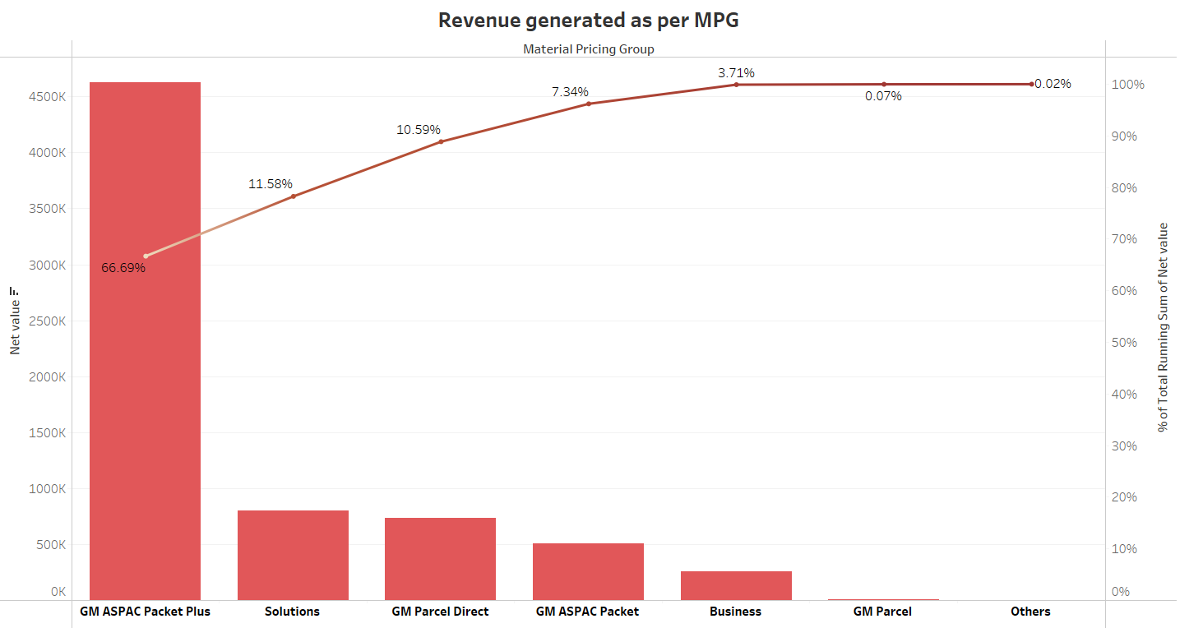
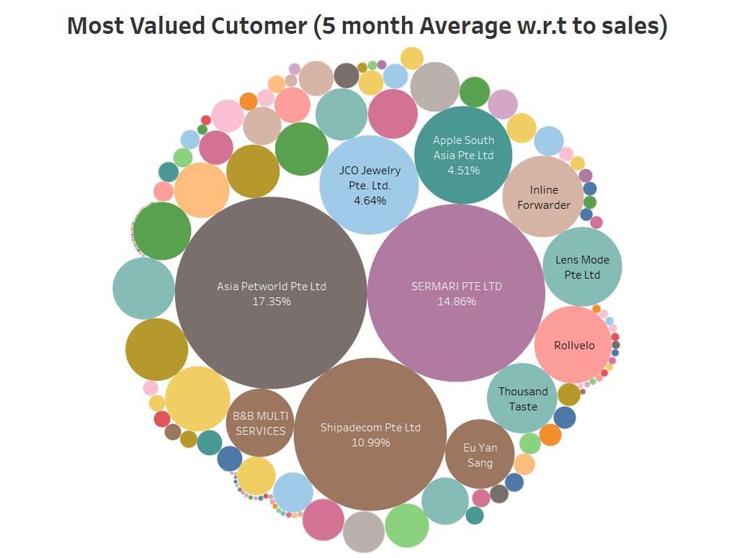
AGENDA | COMPANY OVERVIEW | PROJECT OBJECTIVE| MIDREVIEW RECAP| DASHBOARD | TIME SERIES & REGRESSION | RECOMMENDATION
1.As per ABC analysis our suggestion will be to concentrate on packet plus & parcel direct as they cover 80% of the revenue.
2a. Utilize your best available resources for managing accounts such as Asia Pet world, Sermari Pte Ltd , Shipadecon Pte. Ltd.
2b. Roll out more promotional offers for Key accounts such as JCO Jewelry ,Lens Mode , Apple South East Asia.
(Present In charge :Mr. Albert handling 87 accounts)

Slide 10
ACTUAL VS. FORECAST
AGENDA | COMPANY OVERVIEW | PROJECT OBJECTIVE| MIDREVIEW RECAP| DASHBOARD | TIME SERIES & REGRESSION | RECOMMENDATION
WHAT IF ANALYSIS
3. For weekly forecasting model we can try using the equation :
Sales= 157885.1 + 2.721*Bill Qty in SKU
Unless for other factors are studied to refine the model further.
4. Quite a shipments for eg. Australia & South Africa needs more attention in terms of lead time matching the average requirements.
The Tableau Dashboard can be used to fetch better insights on such ambiguity.

